Slide 1
SONIC
MEMBERS:
TEH CHANG ERN
KANG YU HUAI
KUAY SAY BIN

Slide 2
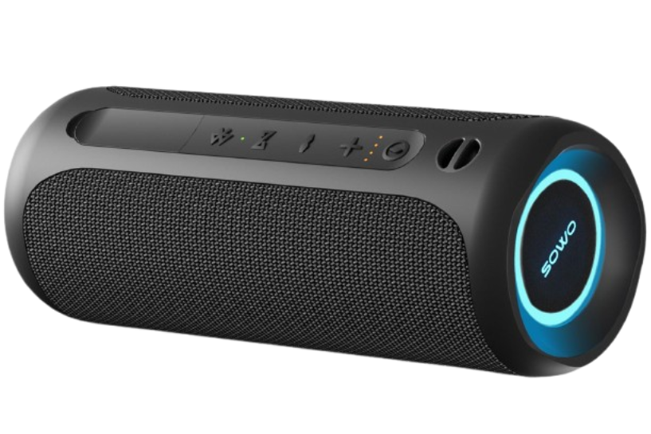
MEMBERS:
TEH CHANG ERN
KANG YU HUAI
KUAY SAY BIN
MEMBERS:
TEH CHANG ERN
KANG YU HUAI
KUAY SAY BIN
auron
OBJECTIVE:
TO SELL DIFFERENT SPEAKER PRODUCTS ONLINE
SONIC

Slide 3
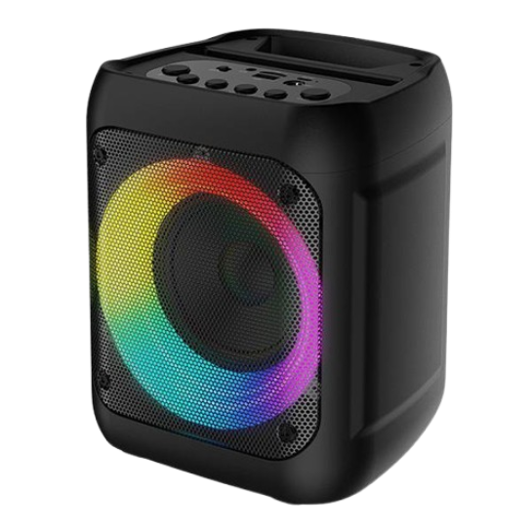
auron
A MODERN, USER-FRIENDLY ONLINE STORE THAT SELLS SPEAKERS
OBJECTIVE:
TO SELL DIFFERENT SPEAKER PRODUCTS ONLINE

Slide 4
why we choose online speaker store?

Slide 5

why we choose online speaker store?
THEY ARE POPULAR, EASY TO SHOW, AND FUN TO DESIGN.
ALSO, SPEAKERS NEVER GO OUT OF STYLE — AND THEY’RE THE ONLY PRODUCT THAT CAN TALK BACK!

Slide 6
GREEN AND CYAN THEME
DESIGN
DARK MODE
the reason behind our design

Slide 7
GREEN AND CYAN THEME
DESIGN
GREEN AND CYAN THEME
DARK MODE
DESIGN
the reason behind our design
makes people look more pleasing to the eye and not too bright

Slide 8
DESIGN
DARK MODE
GREEN AND CYAN THEME
the reason behind our design
makes people look more pleasing to the eye and not too bright
feel modern, fresh, and techy
Green : gives a sense
of energy and
trust
Cyan : adds a cool,
digital vibe.

Slide 9
DARK MODE
GREEN AND CYAN THEME
DESIGN
the reason behind our design
be clean and easy to use.
makes people look more pleasing to the eye and not too bright
feel modern, fresh, and techy
Each part has its own section —> product, review, checkout :
so users can find what they need fast.
Green : gives a sense
of energy and
trust
Cyan : adds a cool,
digital vibe.

Slide 10
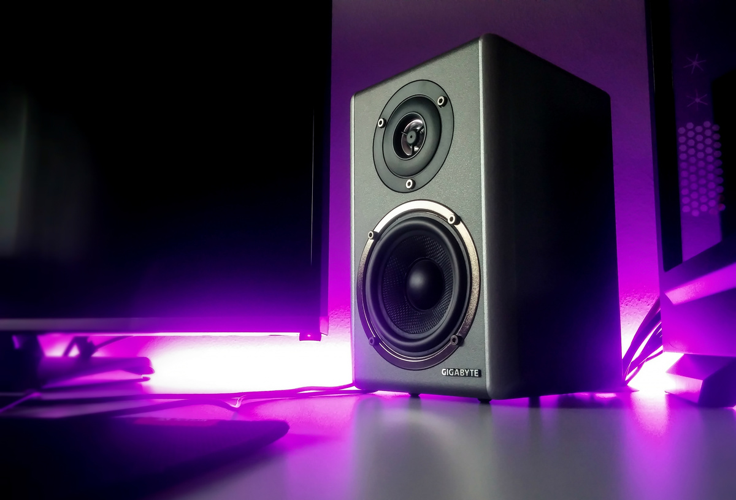
The story why we create this product
the story about why we create it?
Nowadays, most speakers on the market are not built to withstand water, drops, or extreme conditions, which limits where people can take their music. We identified a significant gap for a high-quality, truly portable speaker. Ultimately, we were motivated to help people get more out of their adventures. Our goal was to build a product that provides the perfect soundtrack to a hike, a campfire, or a day at the beach, without the worry of it failing.

Slide 11


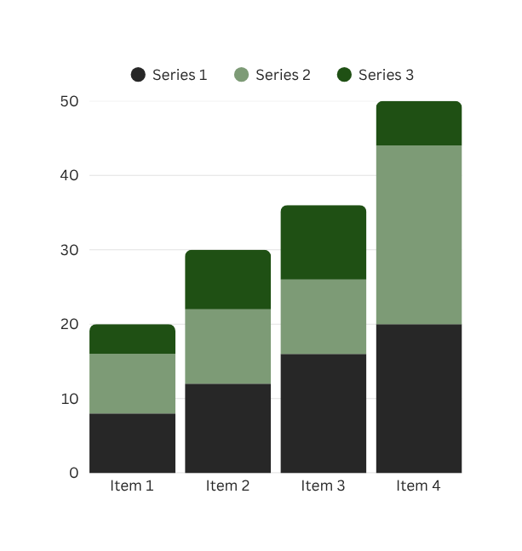
MOTIVATE US TO CREATE THIS PRODUCT.
the story about why we create it?
Customer commented on our product and said, "The sound quality is unmatched. I take it everywhere!" & "Best portable speaker I’ve ever owned. Worth every penny." These comments motivate us to make this product.

Slide 12


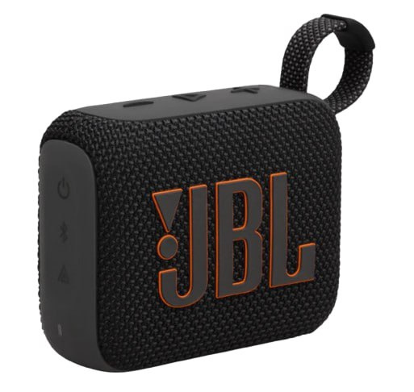
OUR AUDIENCE:
our target audience
Enjoy outdoor activities such as hiking, camping, or spending time at the beach.
Are travelers who need a durable, portable speaker for their trips.
Want a reliable and rugged device that can withstand various environments without fear of damage.

Slide 13



DEVELOPMENT

Slide 14
TOOLS AND TECHNOLOGY
DEVELOPMENT
We use Visual Studio Code to code our website

Slide 15

TOOLS AND TECHNOLOGY
We use Visual Studio Code to code our website
DEVELOPMENT
Visual Studio Code

Slide 16

TOOLS AND TECHNOLOGY
DEVELOPMENT
Chat GPT

Slide 17

TOOLS AND TECHNOLOGY
Assist us on coding our website
DEVELOPMENT
Chat GPT
Gemini

Slide 18
TOOLS AND TECHNOLOGY
HTML
SQL
CSS
Programming languages
PHP
JavaScript

Slide 19
TOOLS AND TECHNOLOGY
Era100.html
index.html
Jbl.html
payment.html
UTL-Specs.html
Ventura.html
SQL
HTML
CSS

Slide 20
TOOLS AND TECHNOLOGY
admin.css
Era100.css
Jbl.css
payment.css
style.css
UTL-Specs.css
Ventura.css
HTML
CSS
JavaScript

Slide 21
TOOLS AND TECHNOLOGY
Era100.js
Jbl.js
payment.js
search.js
Ventura.js
CSS
JavaScript
PHP

Slide 22
TOOLS AND TECHNOLOGY
admin.php
data.php
JavaScript
PHP
SQL

Slide 23
TOOLS AND TECHNOLOGY
database, store record of the payment
PHP
SQL
HTML

Slide 24
Key Features of Website

Slide 25
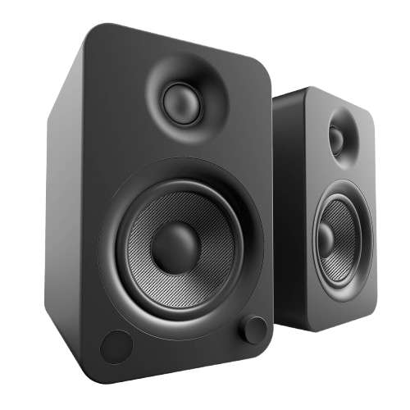
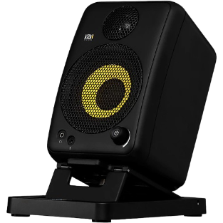
Main Functionalities
<Product Showcase>
<Interactive Color Options>
<Testimonials Section>
<Built-In Purchase Workflow>
<Search Bar UI>
<Smooth Navigation>

Slide 26
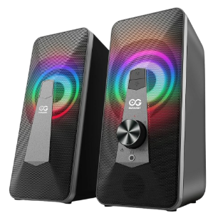
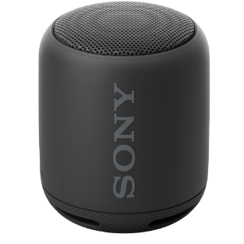
Design Elements
<Green & Cyan Theme>
<Video Hero Section (on homepage)>
<Clean, Modular Layout>
<Consistent Navbar & Footer>
<Hover & Button Effects>
<Responsive-Friendly Design>

Slide 27

LASTLY
To improve the site, we suggest using modern fonts, cleaner spacing, and product tags like “New” to enhance the look. Making the search bar work, adding image zoom, and improving mobile responsiveness will boost usability. A proper checkout confirmation page and form validations will make it feel more complete. For better experience, adding dark mode, star ratings, and a scroll-to-top button would help. In the future, features like user login, order history, real payment, and speaker sound previews could take the site to the next level.

Slide 28
THANK YOU
PRESENTED BY:
TEH CHANG ERN
KANG YU HUAI
KUAY SAY BIN

